Slide 1
Background process

Slide 2
UIThread
The UIThread is the main thread of execution for your application. This is where most of your application code is run.
All of your application components (Activities, Services, ContentProviders, BroadcastReceivers) are created in this thread, and any system calls to those components are performed in this thread.
For instance, let's say your application is a single Activity class. Then all of the lifecycle methods and most of your event handling code is run in this UIThread. These are methods like onCreate, onPause, onDestroy, onClick, etc.

Slide 3
AsyncTask
The AsyncTask class allows to run instructions in the background and to synchronize again with the main thread. It also reporting progress of the running tasks.
AsyncTasks should be used for short background operations which need to update the user interface.

Slide 4
To use AsyncTask you must subclass it. The parameters are the following
AsyncTask <TypeOfVarArgParams, ProgressValue, ResultValue>.
An AsyncTask is started via the execute() method. This execute() method calls the doInBackground() and the onPostExecute() method.

Slide 5
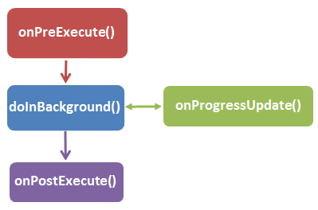
AsyncTask – The 4 steps
When an asynchronous task is executed from UI main thread, the task goes through 4 steps:

Slide 6
onPreExecute
Invoked before the task is executed ideally before doInBackground method is called on the UI thread. This method is normally used to setup the task like showing progress bar in the UI.

Slide 7
doInBackground
Code running for long lasting time should be put in doInBackground method. When execute method is called in UI main thread, this method is called with the parameters passed.

Slide 8
onProgressUpdate
Invoked by calling publish Progress at anytime from doInBackground. This method can be used to display any form of progress in the user interface.

Slide 9
onPostExecute
Invoked after background computation in doInBackground method completes processing. Result of the doInBackground is passed to this method.

Slide 10
AsyncTaskLoader
android.content.AsyncTaskLoader<D> is a loader that uses AsyncTask to perform the task.
It is an abstract class and to use it we need to extend and override its methods.

Slide 11
methods
loadInBackground() : Performs actual task in background and returns the result
onCanceled(D data) : This method is called if task is cancelled before completion. It is used to clean up data post cancellation.
cancelLoadInBackground() : We override this method to cancel the background process. If there is no process in background, it is not going to be called.

